Slide 1

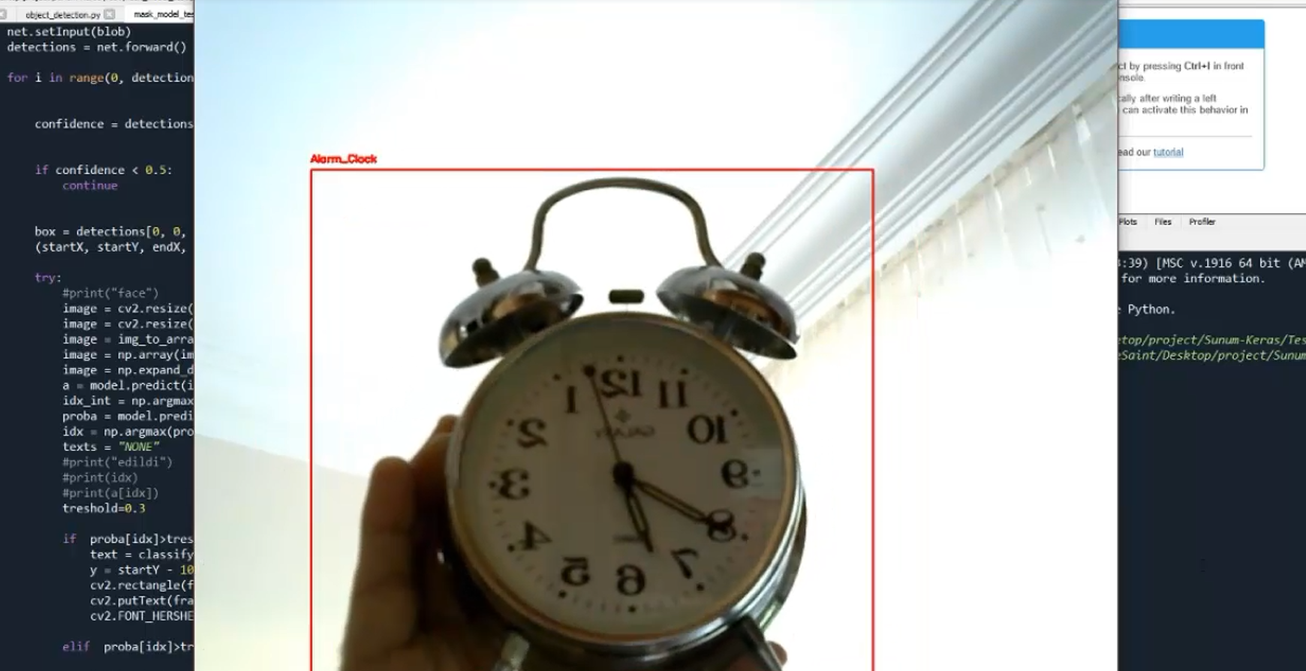
Real Time Image Classification Method Using Computer Vision Techniques and Customized CNN Model
CANSU IŞIK
ÖMER FARUK KÜÇÜK
1906326
1900195
Notes:
Hello, my name is Ömer Faruk Küçük and my Project partner is Cansu Işık. Our Project is Real Time Image Classification Method Using Computer Vision Techniques and Customized CNN Model.

Slide 2

DESCRIPTION OF THE PROJECT
The project examines practices of image classification.
The aim of the project is to create a CNN model that is made more efficient with the help of some Computer Vision techniques and compare the efficiency of our model with the MLP and SVM models.
After having an accurate result, we created a real time application with the help of a pre-trained object detection algorithm, after the object detection is made, our image classification model classifies the image and gives us the label as a result.
Notes:
Our Project is about image classification with a CNN network.
Our aim was make an efficent CNN model and compare that model with the SVM and MLP models.
While doing that, to increase the accuracy, we had to do some preprocessing to our image data.
After creating our model, we made our real time application. Our application uses a pre-trained detection algorithm to choose the images that is going to be classified by our model.

Slide 3
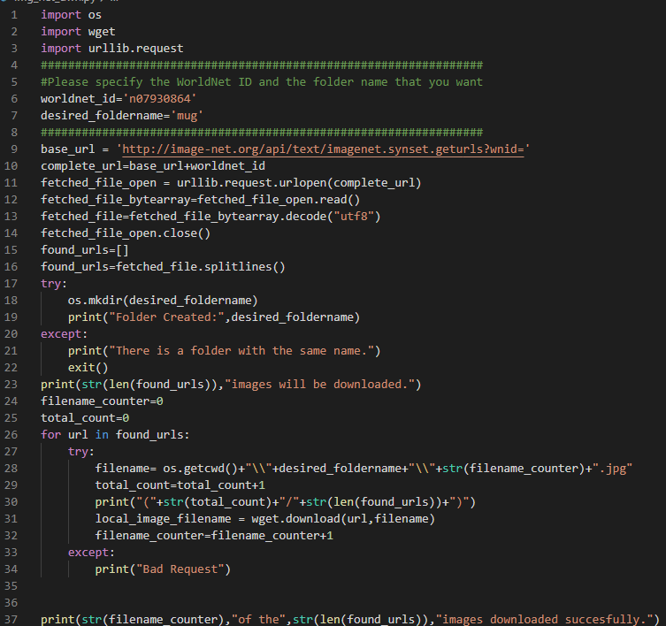
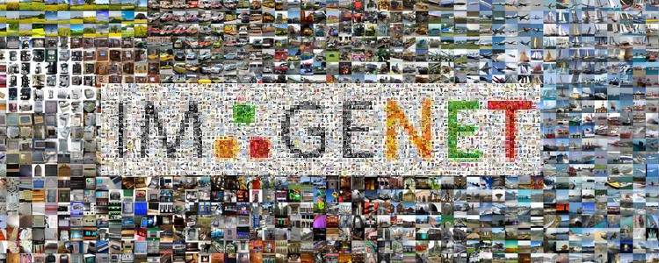
GETTING THE DATA
We took our images from ImageNet platform, which has more than 14.000.000 labeled images.
To accomplish that, we created a Python program, which searches over the ImageNet ID’s and gets the images from URL’s.
Notes:
ImageNet is a huge labeled image network. They have more than 14 million labeled images. ImageNet stores URL’s that refers to the images and their label informations. We created an application to go and download images from the ImageNet network by the label id numbers. With that program, we collected most of our data. After collecting some amount of data, we erased some unrelated images with our hands.

Slide 4










OUR DATASET
Scissors: 273
Keyboard: 255
Pen: 253
Mug: 250
Mouse: 229
Glasses: 173
Batteries: 173
Fork: 133
Alarm Clock: 127
Notes:
Our dataset has 9 categories.
Most of our samples has the Scissors as a label, least sample size is belongs to the Alarm Clock.
But for an example, alarm clock images are mostly about some spesific clock type, so it’s giving very good predictions about the same clock type.

Slide 5
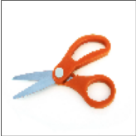



RESIZING
DENOISING GAUSSIAN BLUR
SEGMENTATION GRAYING AND TRASHOLDING
MORPHOLOGYBACKGROUND
To adjust the input size, we are resizing the image.
We resize each image in our dataset to 100x100.
Having smaller sizes reduces the accuracy, but having bigger sizes increases the processing time.
We are applying Gaussian Blur to smooth our image and remove unwanted noise.
We are segmenting the image, seperating background from foreground objects.
To find a sure background area, we are using dilating.
Notes:
We made some operations on our images.
We resize all of our images to 100 to 100, the reason is we need to have all of our images with the same size.
If we increase the size the accuracy also improves, but the proccesing time is increasing too much.
To smooth the sharp parts and remove glitches we use the gaussian blur on our images.
Then we are going to the segmentation phase. We are graying and tresholding our images as you can see.
Then we are going to the morphology phase, to find a background area we are using dilating.

Slide 6
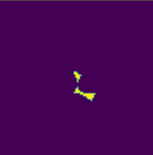

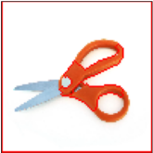

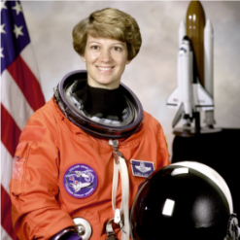
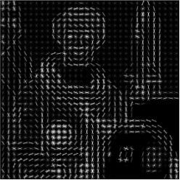
MORPHOLOGY FOREGROUND
MORPHOLOGY UNKNOWN AREAS
MORPHOLOGY MARKING
HOG TRANSFORM
To find a sure foreground area, we are applying distance transform and tresholding again.
Converting 0 to 1 image data to the 0 to 255 image data with uint8, then substracting background from foreground to find the unknown area.
We are labeling the markers, to seperate different objects in the image, we are doing the following.
Adding 1 to all labels to change the background form 0 to 1. Then we are marking the unknown areas with 0.
To mark the objects, we are watersheding.
We applied and tried HOG (Histogram of Oriented Gradients) Method to the SVM model inputs.
Image is broken down into smaller regions and for each region gradients and orientations are calculated.
HOG would generate a histogram for each of this regions.
Notes:
So , to find the foreground area, we are applying distance transform and trasholding.
To find the unknown areas we are subtracting background from foreground.
At the end, we are adding 1 to all labels to change take the inverse of the background. Then we are marking the unknown areas with 0 and it gives a result as you can see from the image. It nearly gives a good shape to work on.
For SVM, we used Hog transform method. Histogram of Oriented Gradients method. It brokes down the images into smaller regions and for each region, it calculates the gradients and orientations.
Hog would generate a histogram for each of this regions.

Slide 7



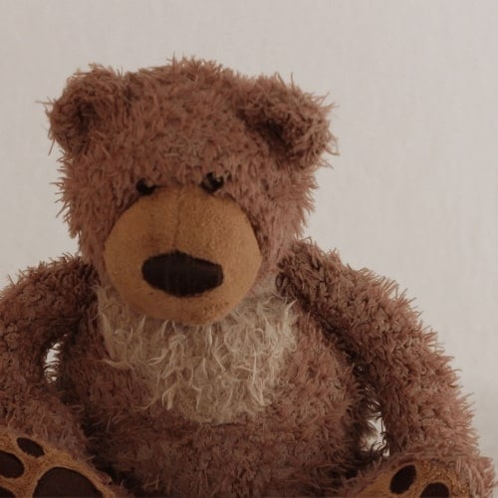

DATA AUGMENTATION
Image Augmentation is a technique for artificially expanding the size of the dataset.
It creates modified versions of the images in the dataset.
Showing a shape with different directions while training the model improves the training performance.
Our modifications over the augmented data is 25 degree randomly rotation, 0.1 shifted pixels both width and height, 0.2 shear degree and zoom angle and for the last horizonally flipping.
Original
Rotate
Shift
Zoom
Flip
Notes:
To have a better accuracy, we populated our image data with Data Augmentation. So it is creating modified versions of the images in the dataset. The images that you see right now, the operations we did to our data. We rotated 25 degree, we shifted with 0.1 pixels, we zoomed as 0.2 and we flipped horizonally at our augmented data.

Slide 8
BINARIZING
Since our label data is categorical, we are binarizing the labels at the size of our total categories. When our model predicts a value, it predicts a score for each label binary between 0 and 1. Biggest number is the strongest prediction.
Notes:
So our classes are categorical. Thats because we are binarizing the labels and giving them our model with numerical values.
When our model predicts a value, it is predicting 9 different numbers between 0 and 1. We are doing an argmax operation to get the index of the biggest value.
From here, we can understand that the category, that has the index of 7, has the biggest prediction. Let’s say the pen is the 7th category, so we are saying with a possibilty of 55% this item is a pen.

Slide 9
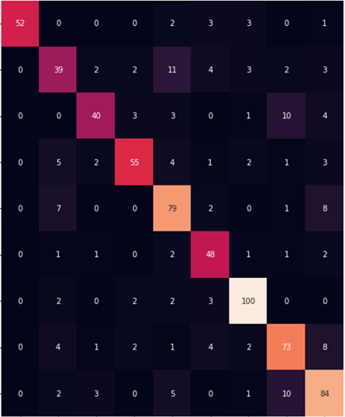
SVM
After preproccesing the dataset, we applied Hog transform to our data.
We tried several Hog transform parameters and kernel types.
After the GridSearch, test accuracy was 80%.
Best predicted images are from the Alarm Clock images.
At the predictions, highest missclassification rate belongs to Keyboard images.
Training Data
K-Fold Cross Validation
Raw Images
HOG Transform
Test Data
SVM
Notes:
After preprocessing dataset we applied Hog Transform then built SVM model.
In the GridSearch :
We tried several Hog Transform parameters,kernel types,Cost parameter
Around %80 test accuracy after GridSearch
Best predicted images from Alarm Clock
Highest misclassification rates predictions belongs to Keyboard images

Slide 10
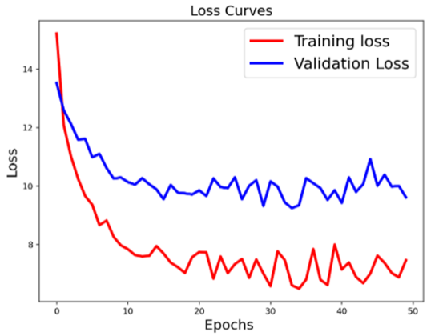
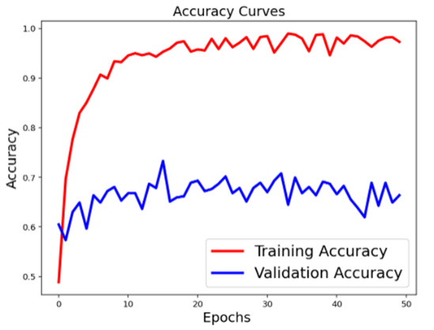
MLP
We created a MLP with 5 hidden layers, 3 different activation functions.
We applied this model for hog transformed and preproccessed images.
At the GridSearch, we checked different learning rates, dropout values and activation functions.
Also we checked the best parameters for the Hog transform.(eg. pixels per cells, oriantation etc.)
Result was still bad, possible reasons can be small sample size, high bias, low variance or we would still search for better parameters.
Notes:
We tried MLP with 5 hidden layers,3 different activation functions to the two types of data (with Hog transformed or without)
In the Grid Search we checked learning rate,drop outs,activation
We also checked the best parameters for Hog transform(pixels_per_cells,orientation etc)
Result is still bad : possible reasons which can be small sample size, different parameters can be chosen
High bias , low variance

Slide 11
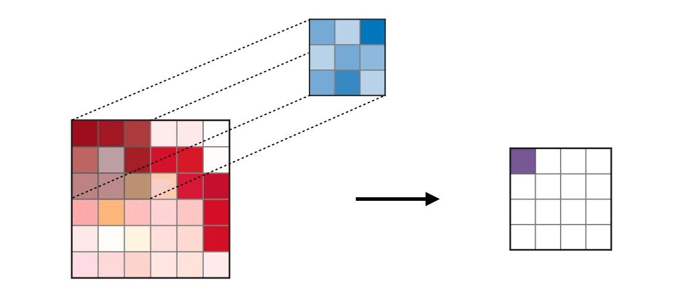
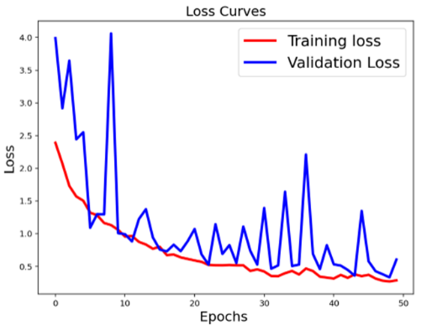
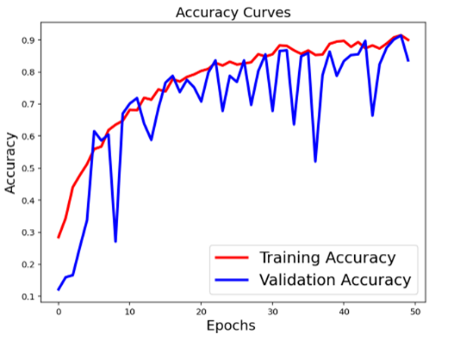
CNN
Architecture is characterized by:
Using only 3x3 convolutional layers stacked on top of each other at increasing depth.
Reducing volume size by max pooling.
Fully connected layers at the end of the network prior to a softmax classifier.
Notes:
VGGNet-like architectures are characterized by:
Using only 3x3 convolutional layers stacked on top of each other at increasing depth.
Reducing volüme size by max pooling.
Fully connected layers at the end of the network prior to a softmax classifier.
Our build method requires four parameters:
Width: The image width dimension.
Height: The image height dimension.
Depth: The depth of the image.
Classes: The number of classes in our dataset.
Model Architecture:
The Convolution Layer has 32 filters with a 3x3 kernel.
We are using RELU as the activation function, followed by Batch Normalization.
Our POOL layer uses a 3x3 POOL size to reduce spatial dimensions quickly from 100x100 to 49x49.
We utilizied Dropout in our network architecture.
No one single node in the layer is responsible for predicting a certain class.
The deeper we go in the network, the smaller the spatial dimensions of our volume, and the more filters we learn.
We round out the model with a softmax classifier that will return the predicted probabilities for each class label.
After we build our model we applied GridSearch with different learning rates,batch size,image dimensions
Optimizer is Adam and activation funciton is Relu.
Results:
For the results we can say because of the high variance and low bias, the model can be counted as Overfit.
One of our primary problems in our model was the small amount of training data.
We tested on various images and at times the classifications were incorrect.

Slide 12
CONCLUSİONS
Histogram of oriented gradient, image segmentation, removing noise etc. helped for pre-processing part of dataset. Data augmentation helped also in this process.
Compared the classification performance with ANN and SVM since SVM gives good results.
We get best predictions on test dataset with our last CNN model.
We also used this models weights for real time detection of our objects with the help of Caffe.

Slide 13
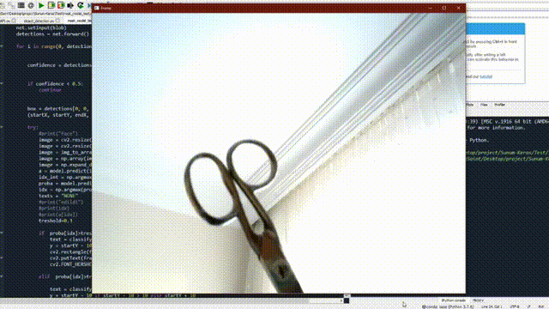
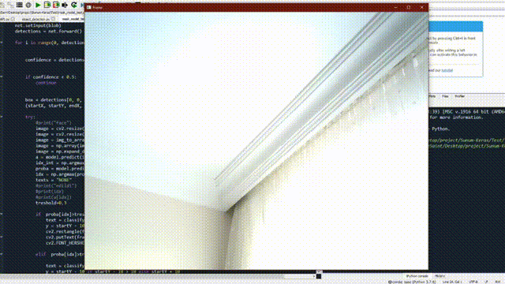
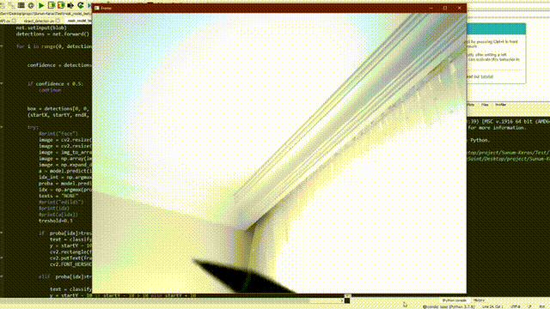
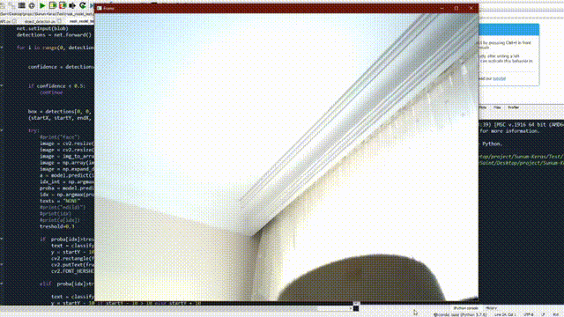

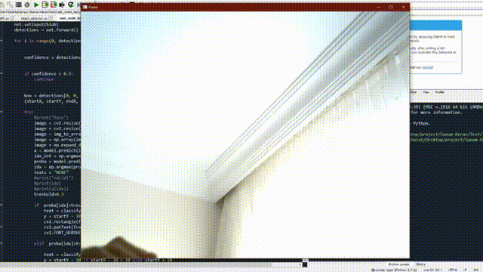
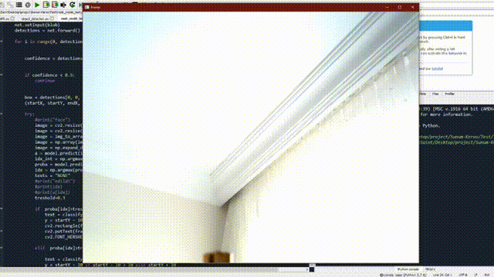
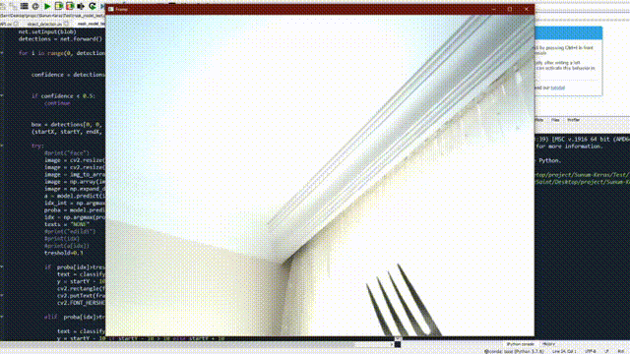
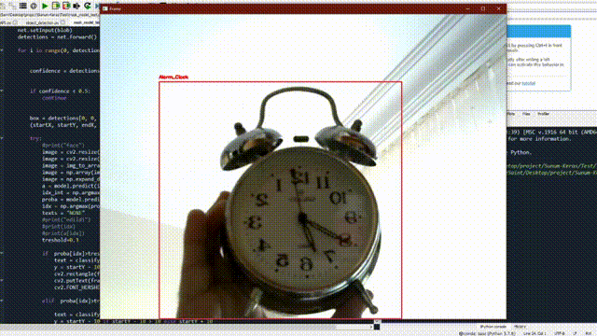
SCISSORS
KEYBOARD
PEN
MUG
MOUSE
GLASSES
BATTERIES
FORK
ALARM CLOCK

Slide 14
END
Thanks for listening.

